Slide 1
Python
For Fun and Professional Profit
Ryan T. Hamilton, Instrument Scientist
Lowell Observatory, July 2018

Slide 2
Step 1:
Figure out what Python is.

Slide 3
Step 1:
Figure out what Python is.
Tip: Don’t do a Google image search. It’s kinda gross.

Slide 4
Python’s Goals:
An easy and intuitive language just as powerful as major competitors. Open source, so anyone can contribute to its development. Code that is as understandable as plain English. Suitability for everyday tasks, allowing for short development times.

Slide 5
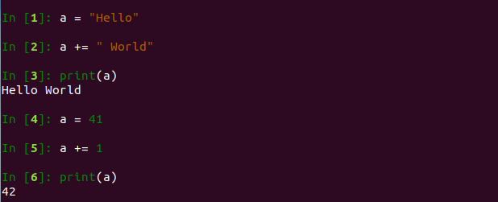
Python Quick Rundown
Interpreted, not compiled
Means errors discovered at runtime, unless you incorporate a linter into your workflow/IDE
Most good IDEs will either bundle one or nag you to incorporate one
Flexible typing
a = ‘Hello’
a += ‘ World’
print(a)
‘Hello World’
a = 41
a += 1
print(a)
42
‘a’ is a string type
‘a’ is now an integer type

Slide 6
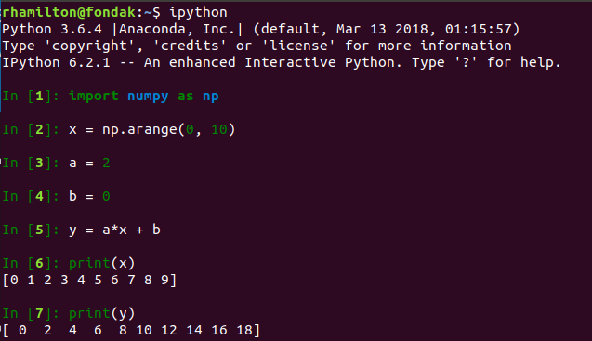
Python Quick Rundown
Array broadcasting!

Slide 7
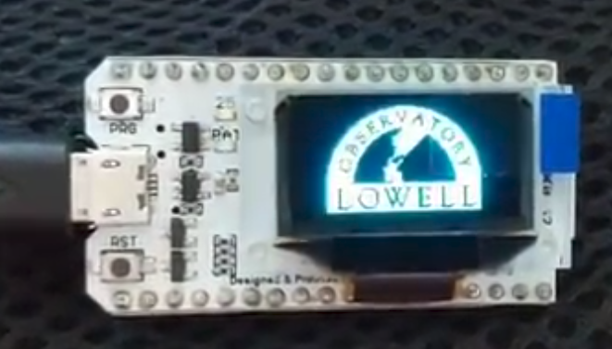
Python Quick Rundown
Other quick boons:
Multiple return values
Pass any variable or object to a function trivially
Pass a function to function which bundles it up in a class and returns it to be passed to another function
Array strides and array slices
Object introspection/discovery (dir() and .__dict__)
Memory is managed for you (no malloc concept)
It’s taking over even the embedded microprocessor space! Great for education!
MicroPython and CircuitPython

Slide 8
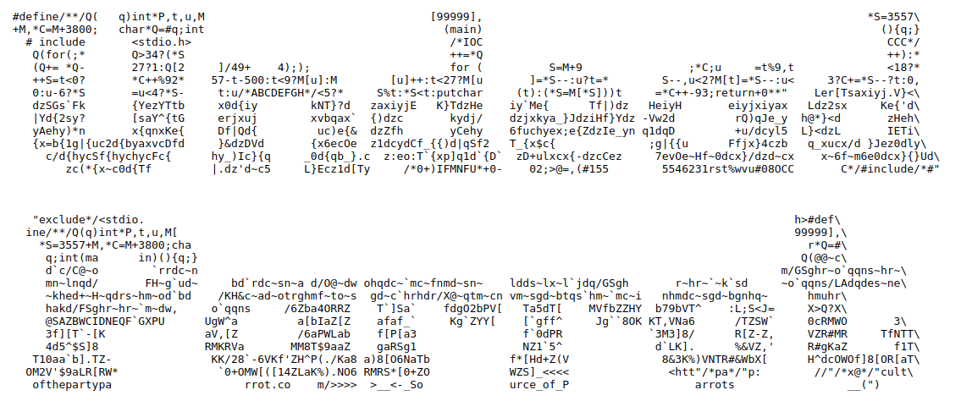
Python Quick Rundown
FORCED code style (via indentation/line spacing)
Avoids this (https://www.ioccc.org/2018/endoh2); it’s valid C code!

Slide 9
Python Quick Rundown
FORCED code style (via indentation/line spacing)
Avoids this (https://www.ioccc.org/2018/endoh2); it’s valid C code!

Slide 10
Python Quick Rundown
Object oriented
Objects have properties/attributes to hold information and methods to act on stuff
Python is class-based; kinda-sorta similar to structures in C or modules in Fortran
C++ and Java are also class-based languages
Typical lingo: “Object X is an instance of class Y”
Extendable via packages
Well-done packages spread via a central repository (pypi.org) and have well-defined versioning and dependencies
Half- or quarter-assed packages have some of that
Zero-assed packages are just blobs of code that do something

Slide 11
Python Quick Rundown
Useful stuff that comes out-of-the box with Python:
String manipulation that won’t make you want to scream at the mountains
A date/time library (“datetime”) that is follows established standards (strftime, strptime)
Can take care of routine calendar math for you
A separate package (“tzinfo”) that takes care of timezone/DST annoyances
Utilities for interacting with the filesystem/host machine in semi-easy ways
Some quirks, same attention to race conditions as any other language needed
Robust logging support (with log rotation!)
Complex generators and tools for iterating across large multidimensional data
Exception/error handling in a sane and graceful way
Basic data compression support (zlib, gzip, bz2, zip files, tar files)
Interaction with sockets, simple email support (including data encoding)
Support for parsing CSV, HTML, XML

Slide 12
Python Quick Rundown
Useful stuff that can be simply added via packages:
N-dimensional arrays, linear algebra, regressions, FFTs, complex math, statistics
numpy, scipy
Full plotting support to a variety of output types (including native PDF/PS)
matplotlib (apes the Matlab plotting interface)
Complex data structure support for dealing with large/weird datasets (like stellar catalogs)
pandas
WCS, VOTable, Tables, FITS, text parsing, statistics, fitting, convolutions, visualizations
astropy
Growing rapidly to encompass imaging and spectroscopic data reductions, even a telescope scheduling optimization module in the works
GUIs
pyqt5

Slide 13
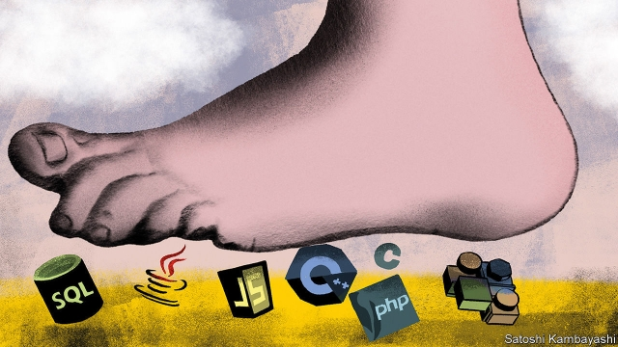

Slide 14
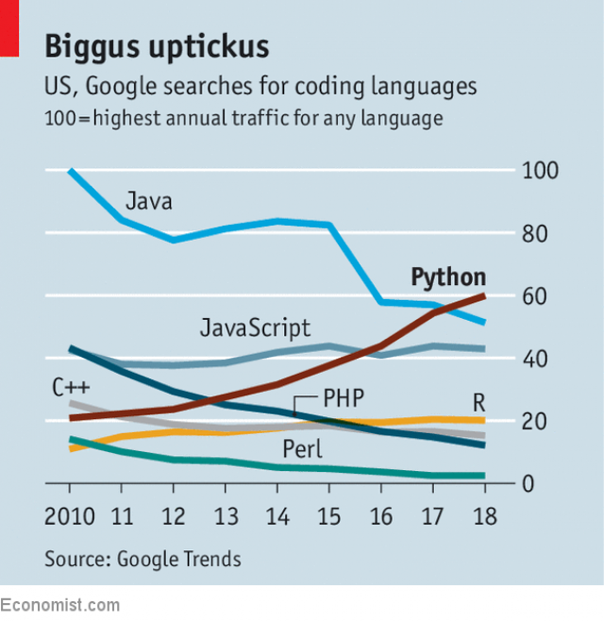

Slide 15
Step 2:
Figure out how to run Python on your daily work computer.

Slide 16

Step 2:
Figure out how to run Python on your daily work computer.
Easy to do these days, no root/sudo access required!

Slide 17
Step 2:
Figure out how to run Python on your daily work computer.
Easy to do these days, no root/sudo access required!
(both are important unless you want the Nicki Minaj song)

Slide 18

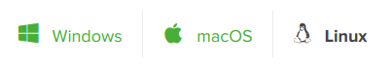
Step 2:

Slide 19
Why Anaconda Python?
Because the Python version by default on your Mac is old.
Because Windows doesn’t come with any version of Python
Because it’s so easy to get going and doesn’t require root access.

Slide 20
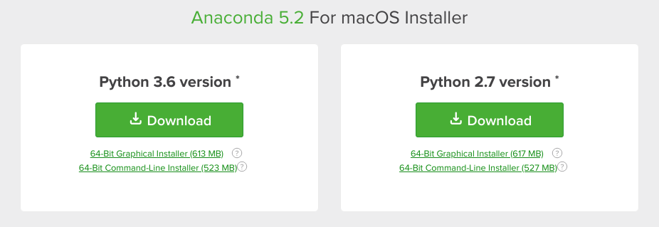
Step 2:

Slide 21
Step 2:

Slide 22
Python 2 vs. Python 3
Don’t use Python 2.X for new code
Python 2.7 will be unsupported on January 1, 2020.
Python 3.1 (first usable 3.x version) released in June 2009
As of 2018-07-25, 341 out of the top 360 Python packages support Python 3.x (http://py3readiness.org/)
Looking at the list of the remaining 19, I only recognized four as useful ones
beautifulsoup, but it is obsoleted in favor of BeautifulSoup4 which is Python 3.x
Parse some truly ugly HTML
ansible and fabric are listed, but they do have Python 3.x support.
sysadmin/IT automation and deployment utilities
MYSQL-python is still on Python 2.x (but there are other DB fish that can be fried)

Slide 23
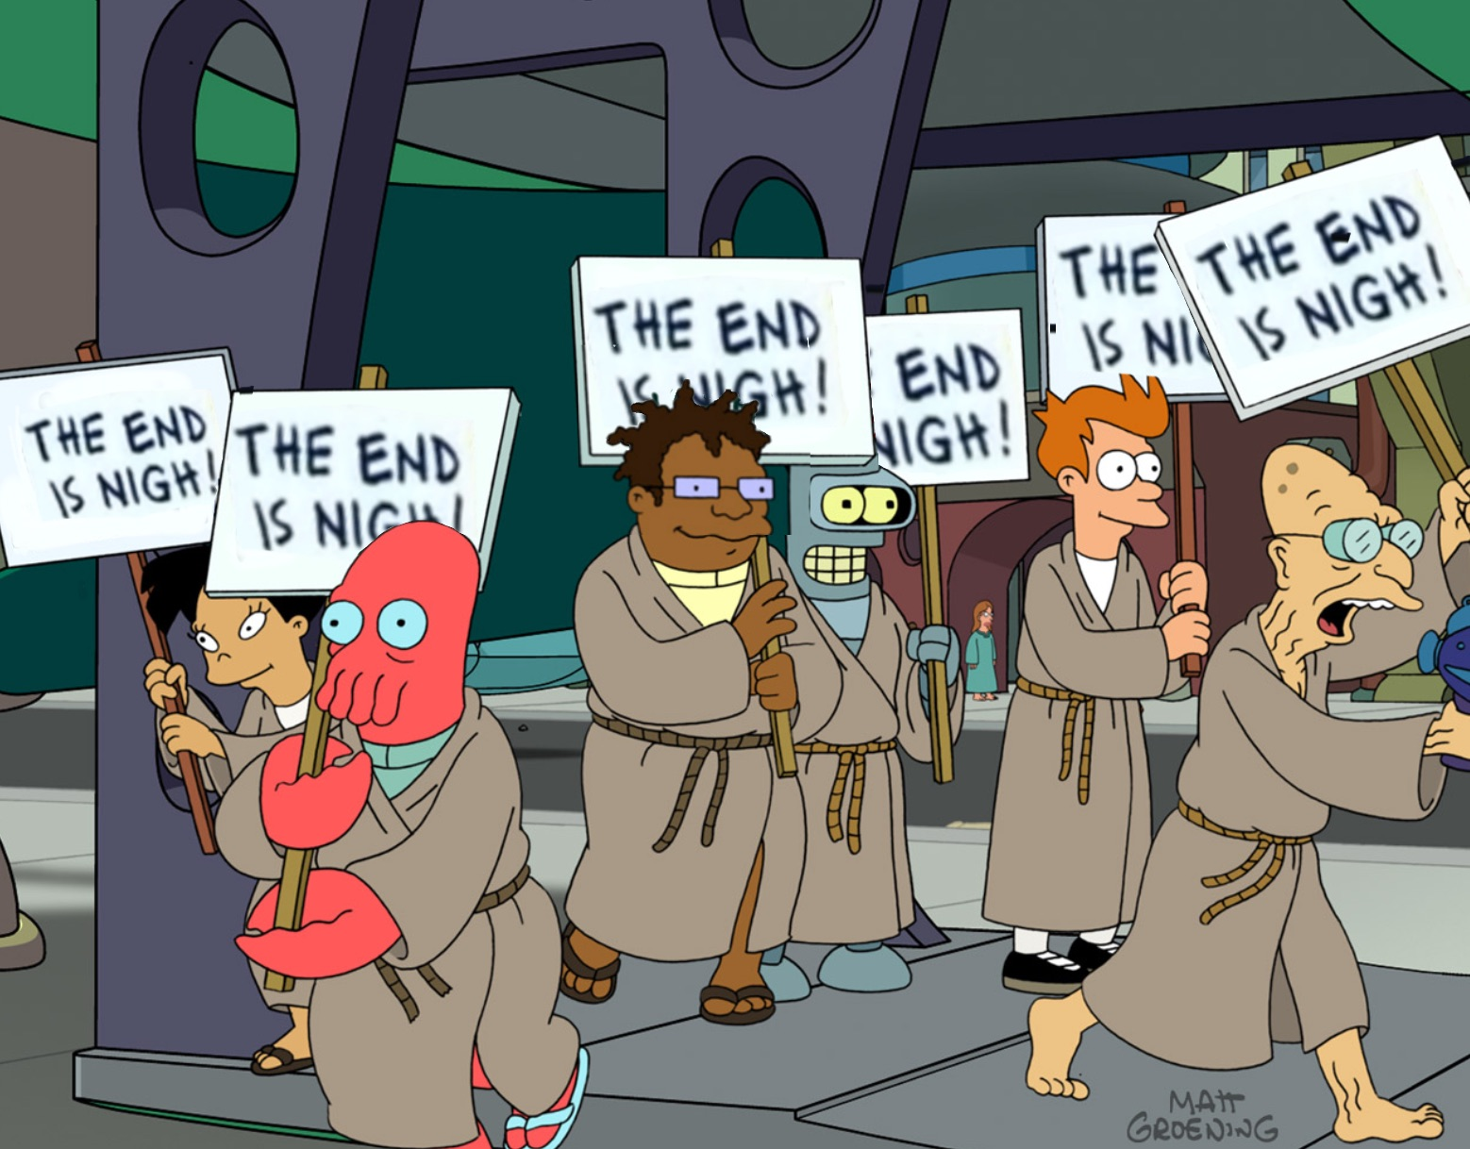
Python 2 vs. Python 3
Don’t use Python 2.X for new code

Slide 25
Step 3⇨N:
Learn Python. There are already great resources out there!
https://git.io/fN0ir
https://github.com/astropy/astropy-workshops/tree/master/aas231_workshop/02-PythonIntro

Slide 26
Time for a few
“Real World” examples
To better show the concepts

Slide 27
State and Define “The Problem”
A FIR inst. on Earth needs to subtract the sky
Need to avoid systematic effects:
Sample the background randomly
Average signals across as many detectors
Telescopes hate to move randomly! Hard to do
Lissajous curves provide the best balance
https://arxiv.org/abs/0806.4888
Want to maximize coverage on detectors given:
Scan speed (RMS),
Scan amplitude (Alt/Az or RA/DEC)
Phase
Duration
How do we pick good values? How do we avoid crappy values accidentally? Code it up!

Slide 28
The Code!
(stop looking at this page)
(don’t look over here either, go load the code)

Slide 29
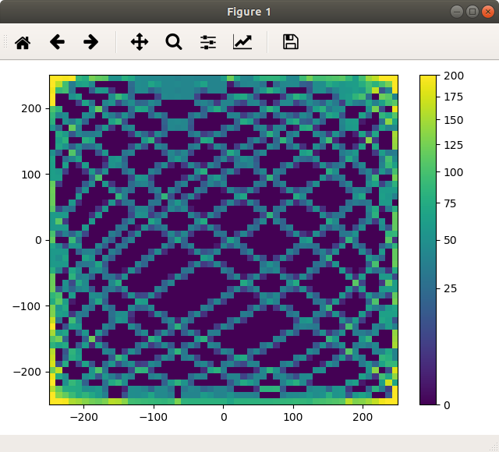
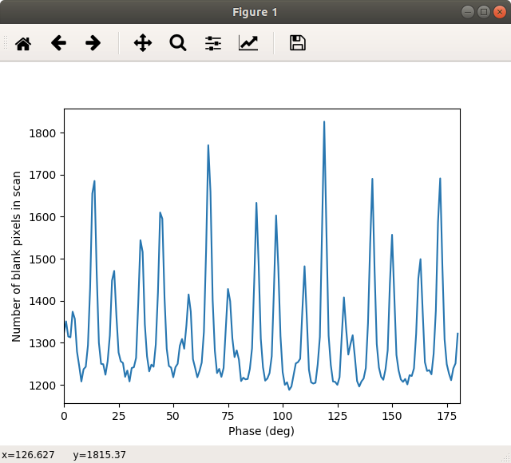
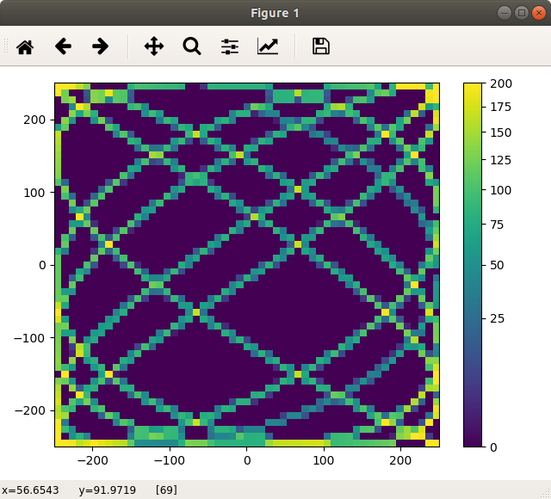
Code Outputs
Lowest num. of empty bins: 1188 (phase = 103 deg)
Highest num. of empty bins: 1826 (phase = 119 deg)

Slide 30
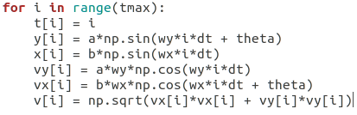
Don’t Write Python Like You’d Write Fortran

Slide 31
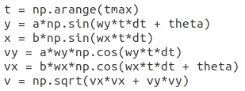
Don’t Write Python Like You’d Write Fortran

Slide 32
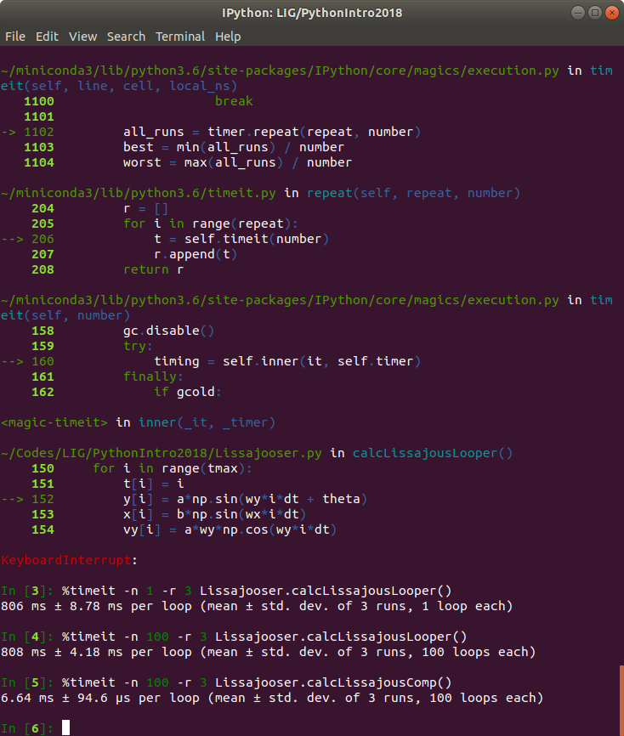
Don’t Write Python Like You’d Write Fortran

Slide 33
Python Tips
Create classes and functions liberally
Modular code is code you can reuse later! Be nice to future you.
AVOID GLOBALS. You’ll thank yourself later!
Think really hard whether you can eliminate explicit loops
Nested loops are even worse, just like in other languages
Experiment! And learn to read the traceback/exceptions
Debugging is ESSENTIAL and knowing (how to read it) is half the battle
Use an IDE (vscode, spyder)
For complicated codes it’ll change your life. Guaranteed!

Slide 34
That’s It!

